Slide 1

Vocabulary Preview
Sample Distance Learning Lesson

Slide 2
The Empty Pot
by Demi
storylineonline.net
Notes:
4. Check for student understanding (use for previously taught letter-sounds)
What letter is this? What sound does it make?

Slide 3
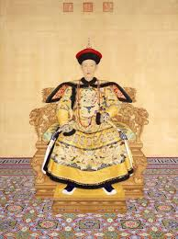
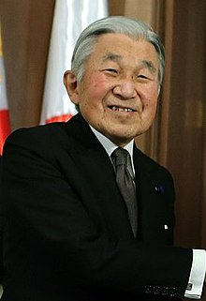
Emperor

Slide 4
Emperor means someone with great power who rules over people, like a king

Slide 5
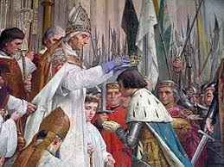
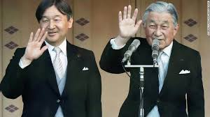
Successor

Slide 6
Successor means
someone who will take the
place of a leader
Notes:
4. Check for student understanding (use for previously taught letter-sounds)
What letter is this? What sound does it make?

Slide 7

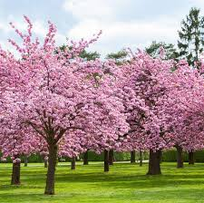
Blossom

Slide 8
Blossom means to grow and open up, like flowers

Slide 9
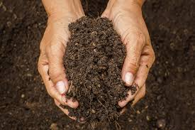
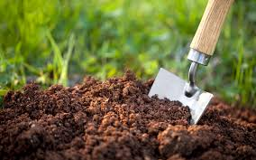
Soil

Slide 10
Soil means dirt or earth

Slide 11



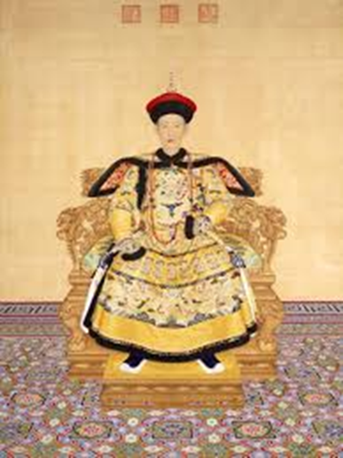
Let’s play a matching game! Point to the picture that matches the word.
Blossom
Successor
Soil
Emperor

